Slide 1
Current status of pulmonary thromboembolic disease.
R. Wagenaar
Stellenbosch university
Tygerberg hospital
11/07/2015

Slide 2
Background
1 in 1000 per year
- Incidence doubles for each 10-year increase in age
- U.S. > 250 000 hospitalisations per year
Immediate Mortality of untreated PE: 30%
With treatment: 2-8%
4x higher risk of death in year following treatment for PE compared to DVT

Slide 3
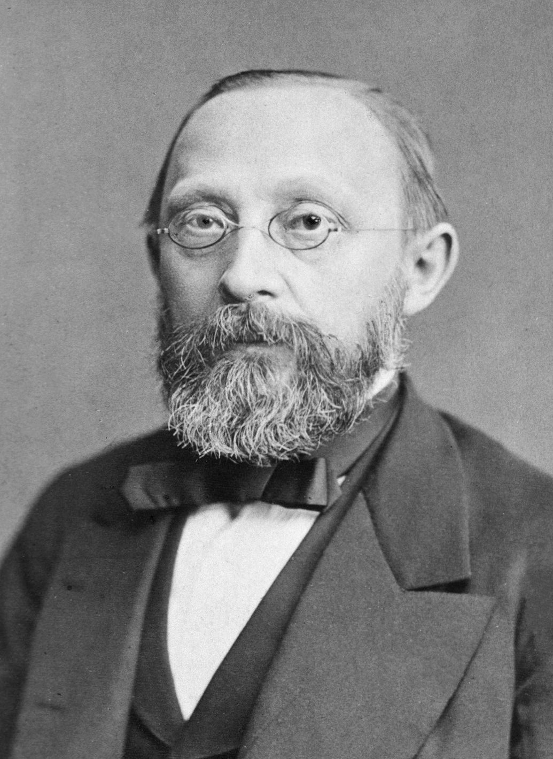
Pathophysiology
Virchows triad: Stasis
Vascular injury
Hypercoagulability
Most emboli from legs/iliac vessels (DVT)
RV dysfunction – clot lodges in PA, arterial
obstruction, vasogenic peptides
via platelets, vasospasm and
increased PVR.
Hypoxia – dead space ventilation, shunt/VQ mismatch
bronchoconstriction increases airway resis.

Slide 4
Pathophysiology
RV dysfunction NB prognosis and treatment inplications
Pressure overloaded RV, septal shift, LV underfilled, decrease output, LV ischaemia and circulatory collapse.
3 major studies show poor outcome with RV
dysfunction (and low BP)
Around 60% mortality with acute PE and RV
dysfunction, most in 1 hr of presentation

Slide 5
Presentation
Acute / Chronic
Massive / Sub-massive / Stable
Clinically:
tachypnoea / cyanosis / CV collapse (shock) / arrhythmia
cardiac arrest / pleuritic chest pain / haemoptysis / non- specific.
DAGNOSIS CAN BE DIFFICULT

Slide 6
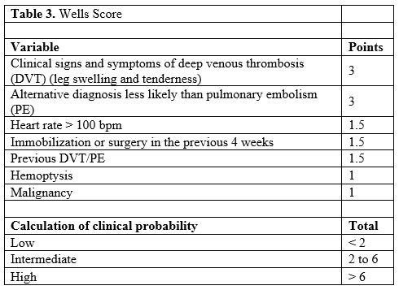
Diagnosis
Wells probability score: (Modified total <4 >4)

Slide 7
Diagnosis
Quantitative D-dimer:
High sensitivity 96%
Low specificity – pneumonia, MI, trauma, sepsis
High negative predictive value (99%), good at excluding clot/PE
Cannot be use for in-hospital patients
If positive – need further imaging

Slide 8
Diagnosis
ABG: not diagnostic, but quantify underlying pathophysiology
RV dysfunction: Trop I, atrial naturetic peptide
ECG: sinus tachy, RV strain (RA enlargement, RVH, RBBB), new AF/flutter, SI QIII TIII
CXR: normal, atelectasis, small effusion, focal oligaemia (Westermark’s sign), peripheral wedge shaped hypodensity, enlarged PA

Slide 9
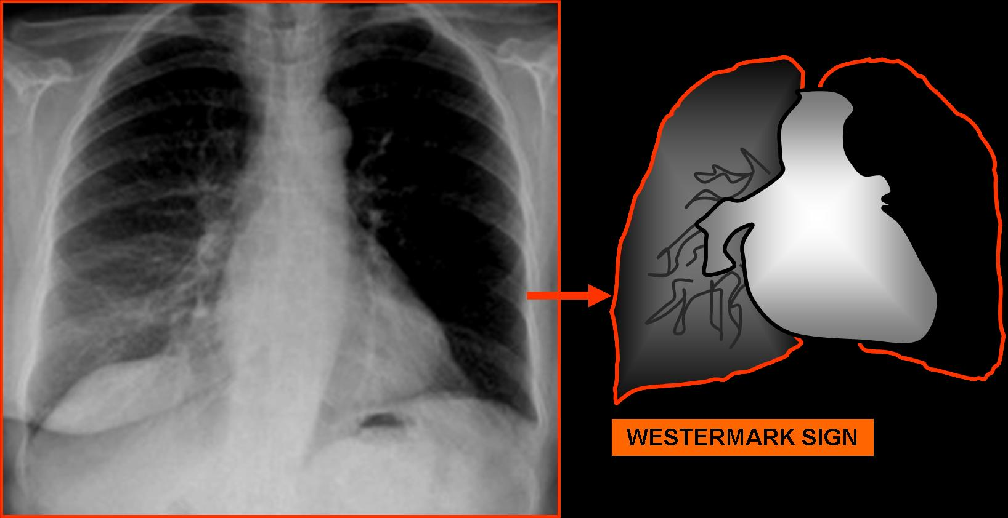
Westermark sign

Slide 10
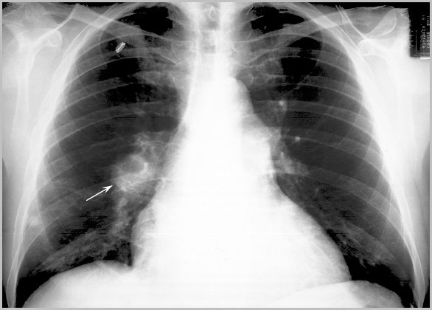
Enlarged RLL PA

Slide 11
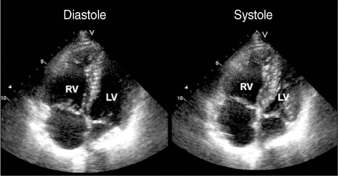
Diagnosis
ECHO:
TTE: easy, non-invasive, shows signs of RV pressure overload
exclude diff diagnosis – MI/effusion/acute MR/aortic dissection
TOE: show site and size of embolus, as well

Slide 12
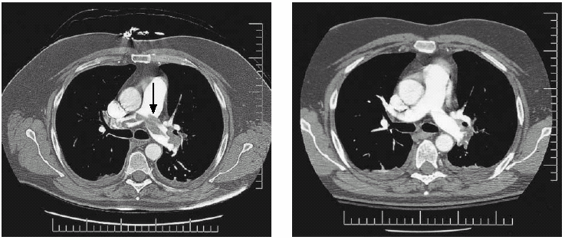
Diagnosis
CT Angiography: now more used than V/Q scan
high sensitivity, esp in central and segmental emboli
provide diff diagnosis

Slide 13
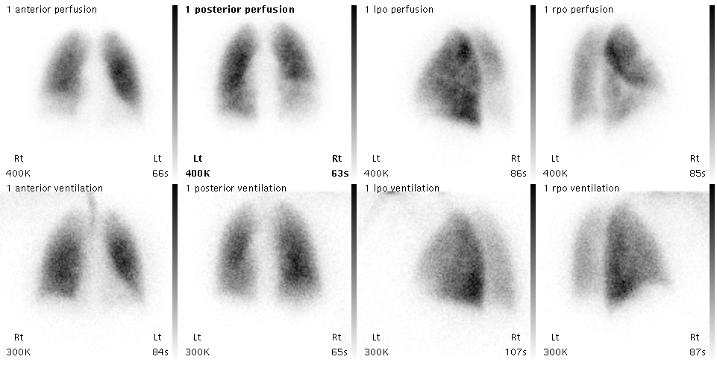
Diagnosis
V/Q Scan: less sensitive than CT PA
structural lung disease/availability/often not diagnostic (60%)

Slide 14
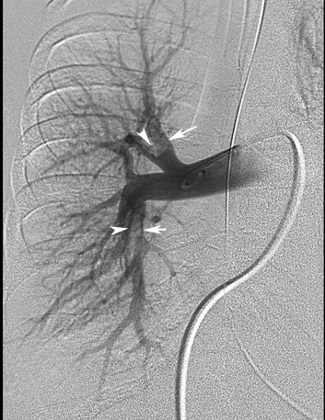
Diagnosis
Pulmonary angiography:
?? CT PA new gold standard
Findings: filling defects/tapering vessel/
slow filling
MRI

Slide 15
Diagnosis
Screen for DVT:
Compression ultrasound/Duplex Doppler/Venogram/MRI/CT venogram
Screen for underlying pathology: malignancies/thrombophillias

Slide 16
Diagnosis - Summary
Probability score (Wells score)
>4 <4
D-dimer
Further imaging High Low
CT / VQ PE excluded
If high probability
TREAT

Slide 17
Treatment
Treatment is according to risk stratification
RV strain
hypoxia
hypotension
High risk: Primary treatment - Thrombolysis/Embolectomy (percutaneous/open)
Secondary treatment – Anticoagulation (Heparin/Warfarin)/IVC filter
Adjuvant treatment – Oxygen/inotropes/fluids
Lower risk: Secondary treatment
Adjuvant treatment

Slide 18
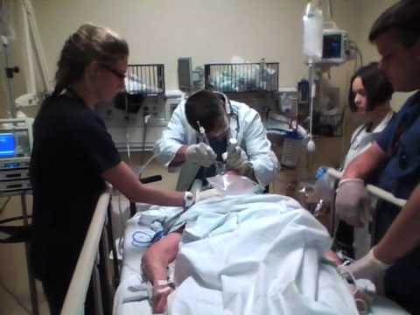
Treatment
Adjuvant treatment
Oxygenate/Ventilate
Circulatory support (esp RV) – inotropes/fluids (careful)

Slide 19
Treatment
Thrombolysis: faster clot dissipation
potential RV failure reverse
dissolves source of clot
decreased recurrence
Risks: Major bleeding (1.3 – 6.1%)
ICH 1.2%

Slide 20
Treatment
Thrombolytic Therapy - Evidence
PE with circulatory collapse
Single study
n = 8, BP < 90 mmHg
4 thrombolysed (all survived)
All 4 NOT thrombolysed died
BTS Guidelines & FDA approval
based on this single study
Jerjes-Sanchez C, et al. Streptokinase and heparin versus heparin in massive
pulmonary embolism: a randomised controlled trial. J Tromb Thrombolysis
1995;2:227-229

Slide 21
Treatment
PE without circulatory collapse, but RV dsfnx
Less evidence, but MAPPED I studies portent trend towards better outcome with thrombolysis
MAPPED III shows definite advantage to thrombolysis than Warfarin and Heparin alone, this arm of the study had to be stopped due to adverse events.
Study conclusion…”can improve the clinical course of stable patients with sub- massive PE”… does not reduce mortality
PE with hypoxaemia
Evidence from small study whow improved oxygenation, and no adverse events
PE With PFO – predictor of mortality

Slide 22
Treatment
Thrombolytic therapy
Streptokinase:
250 000 IU over 30 – 60 min
100 000 IU / hr for 24 hours
rTPA
10 mg stat (1-2 minutes)
90 mg (over 2 hours)
Maximum: 1.5 mg / kg (< 65 kg)

Slide 23
Treatment
Anticoagulation:
Heparin, then Warfarin
Check for CI
Unopposed fibrinolysis
Improves mortality
Agents: Unfractionated Heparin IV / LMWH S/C / Warfarin
2007 Guidelines: LMWH better than UH for DVT
UH equal to LMWH for PE
LMWH has its advantages

Slide 24
Treatment
LMWH VS Warfarin
CLOT study (VTE with cancer) LMWH performed better
New anticoagulants:
Synthetic factor Xa inhibitors - Fondaparinux – SC (non-inferior to LMWH + Warfarin)
Idraparinux – SC ( non-inferior to LMWH + Warfarin, but worse for PE)
Rivaroxaban – PO
Warfarin: agent of choice (INR 2-3)

Slide 25
Treatment
Duration of Warfarin:
1st episode – clear precipitant – 3 months
no apparent cause – 6months
thrombophyllia – lifelong
2nd episode – lifelong/>1yr

Slide 26
Treatment
IVC Filters:
Indications:
Confirmed acute PE, and CI for anticoagulation or bleeding
Recurrant PE despite adequate anticoagulation
Patient not fit to undergo surgery, with massive embolus.
Anticoagulation must be continued when filter is in place.

Slide 27
Treatment
Catheter based treatment:
Pt with contraindication to fibrinolysis
Unstable pt despite fibrinolysis
Transfer pt to facility with catheter based embolectomy if no service available
Surgical treatment:
Used for patients who show new CV instability despite thrombolysis, or who cannot receive it (remove fresh thrombus)
Endarterectomy is used in the treatment of types 1-3 of chronic thromboembolic disease
Mortality ranges from 0-24%, PHT and RV function normalise, NJHA classification is downgraded, TV doe not need to be repaired

Slide 28
